Slide 1
Skin Permeation

Slide 2
Regression Prediction
Cleaning & Preprocessing.
Removing multicollinearity.
Modeling.
Model Explanation: feature importance, and rule based for decision tree.

Slide 3
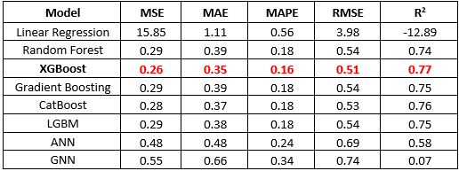
Regression Prediction
GNN is not performing good

Slide 4
Cluster Analysis
Using K-means.
Explaining clusters by using features.

Slide 5
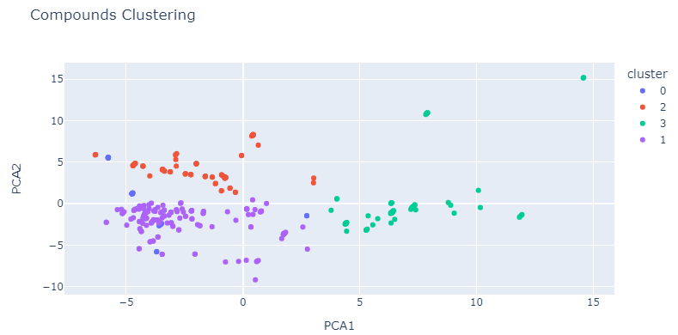
Cluster Analysis

Slide 6
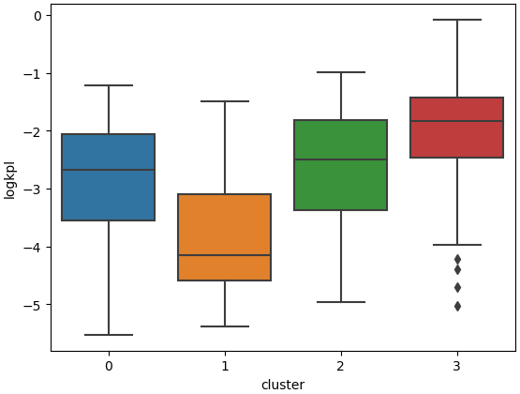
Cluster Analysis

Slide 7
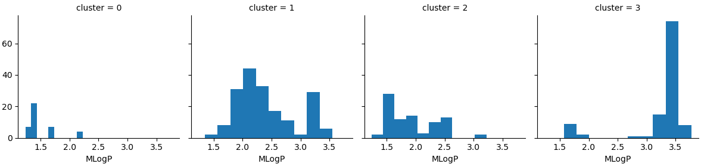
Cluster Analysis

